Slide 1
Precise Positioning and Scanning for Microwave Imaging

Slide 2
Breast Cancer
In Sweden More than 60 000 people per year get a cancer diagnosis.
Over 7500 are breast cancer.
20 Women get breast cancer per day.
30% of all cancer types for women is breast cancer.
The most common cancer among women.
Source: Bröstcancer – symtom, orsaker och behandling | Cancerfonden

Slide 3
Breast cancer screening
X-ray mammography
Microwave Imaging
The most common primary method
Uncomfortable breast compression
Ionizing radiation
Low contrast between glandular and tumor tissue
Low sensitivity -> Radiologist Experience.
Noninvasive
Nonionizing radiation
Higher contrast relation for different tissues
Require a precise positioning of the sender and receiver

Slide 4
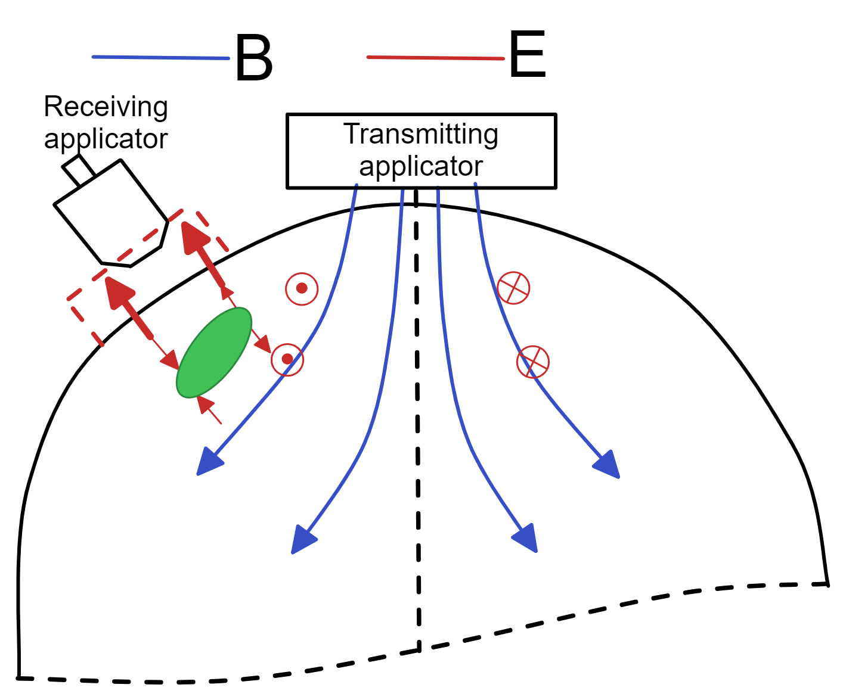
System Description Summary – Microwave imaging
A transmitting applicator sends an electromagnetic wave to illuminate the breast.
Induced current inside the breast generates a scattered field.
A receiving applicator measures the scattered field to retrieve the electromagnetic properties of the breast.
High contrast in the electromagnetic properties between glandular and tumor tissues.

Slide 5
Microwave imaging for breast cancer screening.
No clinical-ready system for hospital usage.
Clinical prototypes for active microwave imaging
Require that the breast is submerged in a liquid tank.
A research group at MDU has developed a new pair of antennas that does not require the liquid tank.
The Microwave imaging require a precise position of the antennas to get good results.

Slide 6
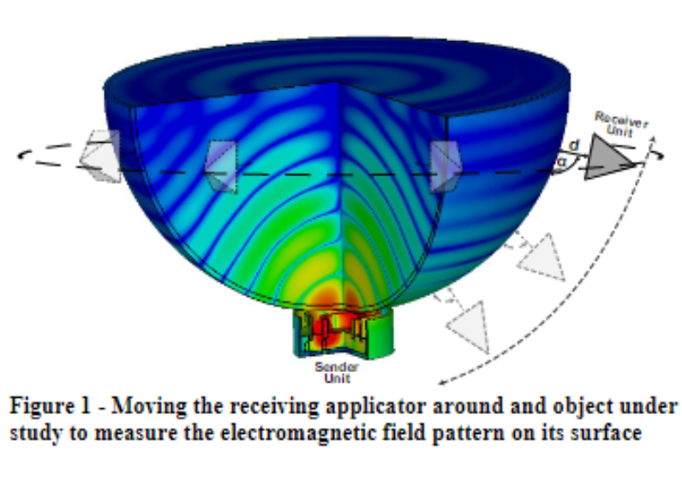
Project Description
The main goal is to automize the microwave measurement procedure.
Develop a robotic system that can place the sender and receiver units around the breast and run an automated measurement sequence.
The distance between the antenna and the breast surface should be controllable.
The angle of incidence should be adjustable.
The system should be able to scan non-symmetrical breast phantoms.
A graphical user interface (GUI) is required to control the system.

Slide 7
Focus this year
The transmitter moves only in one dimension.
The receiver moves in all the required degrees of freedom.
Build a complete system.
Prioritize the precise position of the antenna.
Investigate the data acquisition time.

Slide 8
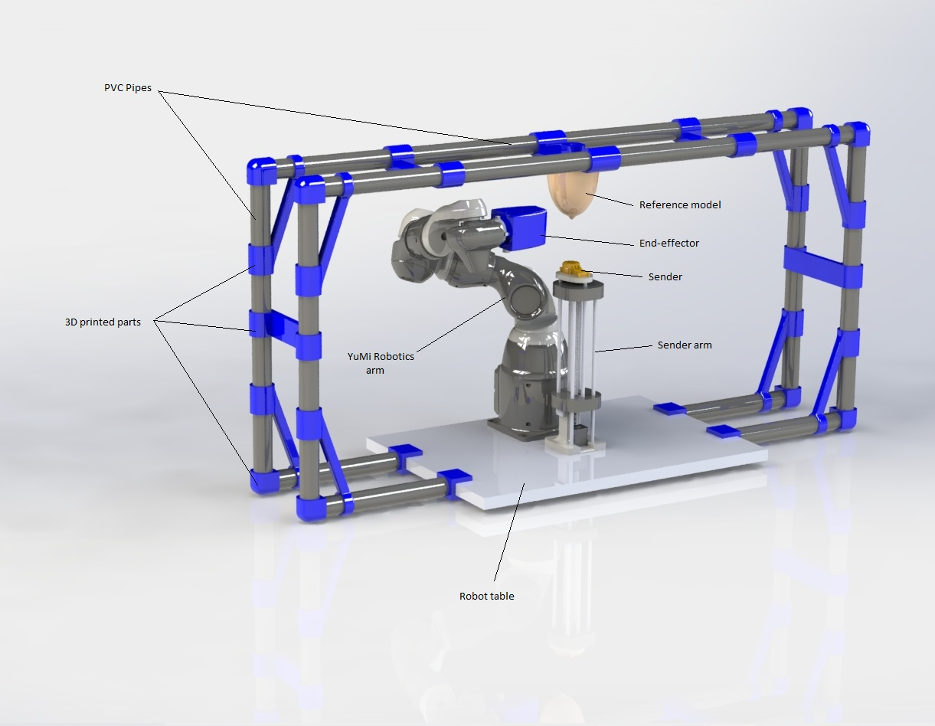
The system overview
The Breast is scanned using a laser sensor to create a point cloud from the breast surface.
Using a surface reconstruction algorithm, we can reconstruct a mesh surface from the point cloud.
Using the GUI the user can choose a scanning point or scanning area with a specified number of points in the Area.

Slide 9
Receiver arm Yumi

Slide 10
Sender arm

Slide 11
Sensor

Slide 12
End-effector

Slide 13
Reference model

Slide 14
System presentation video

Slide 15
How to scan and reconstruct a surface
Choice of the Scanning device and scanning algorithms
Surface preknowledge
Smooth
Convex

Slide 16
How to scan and reconstruct a surface
Reconstruction algorithms
Power crust
Alfa shape
Algorithm requirements
Points density

Slide 17
How to scan and reconstruct a surface
Data and noise
Noise source
Outliers from env
Yumi position
Laser angle/ range optimal
3D printing
Scanning interpolation
Surface reconstruction

Slide 18
How to scan and reconstruct a surface
Scanning protocol approach
Scanning time

Slide 19
Evaluation
End-effector
Laser
Yumi
Yumi Prototype not exactly calibrated
Scanning protocol
0 laser angle 20 spline 18deg , (time)
10 laser angle 20 spline 18 deg , (time)
0 laser angle 4 spline 90 deg ( time)
10 laser angle 4 spline 90 deg (time)
Second approach
Surface Reconstruction
Different protocol plot ( time)

Slide 20
Results
Yumi Prototype not exactly calibrated

